Slide 1
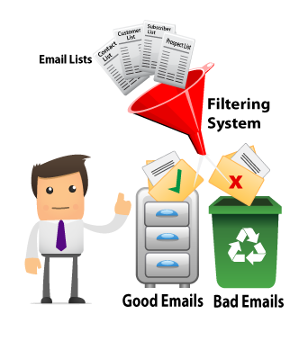
Email Spam Filtering
By Nathan Wikle, Valerie Free, Chris To

Slide 2


Our Topic
Spam filter for emails using Naïve Bayes classifiers
Goal: to create a program that can classify an input email as spam or “ham”

Slide 3

Why Spam Filtering?
Spam filtering is an important process implemented by all modern email providers
Easy enough to develop an effective spam filter for the scope of this project

Slide 4
Background: Naïve Bayes Classifiers
Classifiers are models that assign labels to instances of the problem; in our case, labeling emails as spam or “ham”
Naïve Bayes is a technique for constructing such classifiers
Called “naïve” because it makes strong assumptions about independence of values of features
Is quite effective with some real-world classification problems

Slide 5
Basic Algorithm
Use large training set of emails
Count how many times each word appears in spam and how many times it appears in “ham”
Calculate probability that individual word is associated with spam
Use Multinomial Naïve Bayes Boolean calculation to determine whether an input email is spam, based on probabilities of individual words found in email

Slide 6
Multinomial Naive Bayes
Represent each message as a vector,
x = <x_1, …, x_m>
Consider two classes: spam and ham
Classify message x as spam if
p(c_s) prod{p(x_i|c_s)^x_i
> p(c_h) prod{p(x_i|c_h)^x_i,
where p(x_i|c) = (1 + N_{x_i,c})/(m+N_c).

Slide 7
Results
After training on the entire 33000 emails in Enron, here's the performance at looking at a subset of Ling.
Spam: 0.8958333333333334
Ham: 0.8672199170124482
It adapts fairly quickly, however, after only looking at about 300 of the Ling corpus. The results on the same Ling subset afterwards are:
Spam: 0.9166666666666666
Ham: 0.9543568464730291
And after training on both entire Enron and Ling corpuses (2900), we get almost perfect results after only a few additional emails.
Spam: 0.9791666666666666
Ham: 0.995850622406639

